Slide 1
Task 2 By : Gaurav Sharma
Exploratory Data Analysis
Data Insights

Slide 2
Data Insights – Application data Set

Slide 3
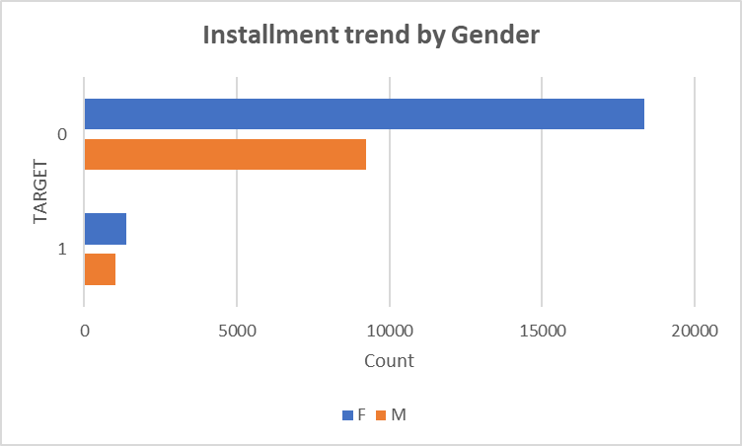
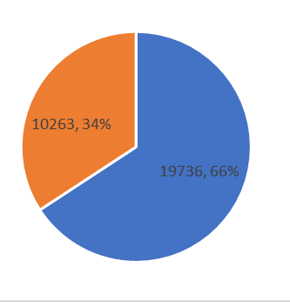
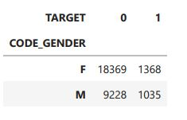
Installment trend by Gender
Females have more payment difficulties as compared to men

Slide 4
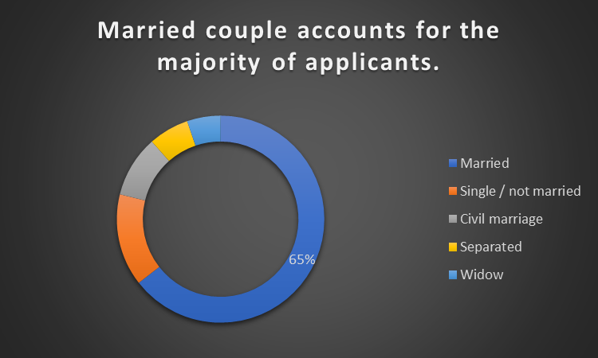
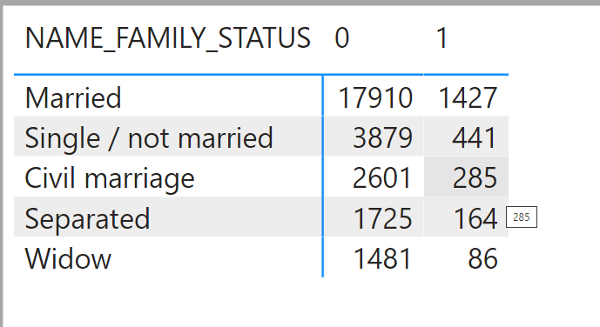
Applicants by Family Status
Most of the applicants are married ones.

Slide 5
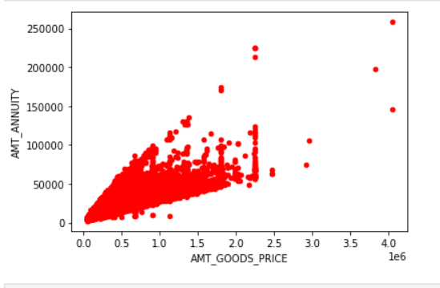
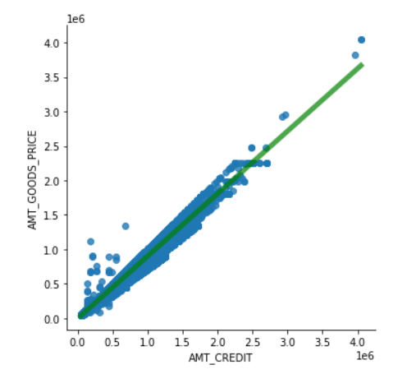
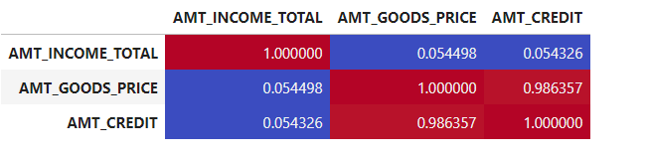
Correlation insights-Continuous Variable
Correlation= 0.98
Correlation= 0.77
Some Higher Correlations

Slide 6
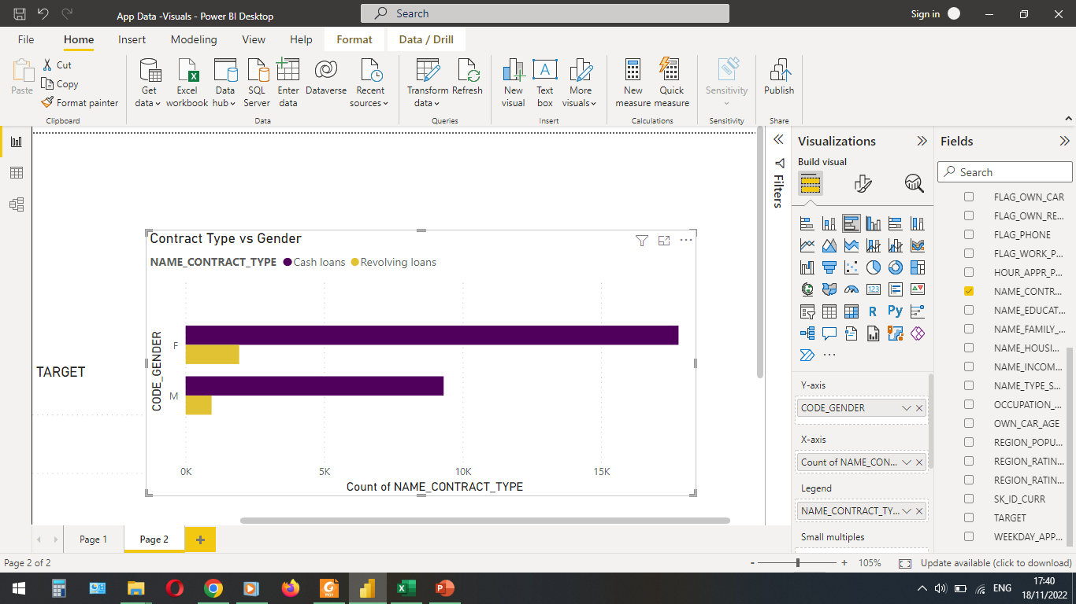
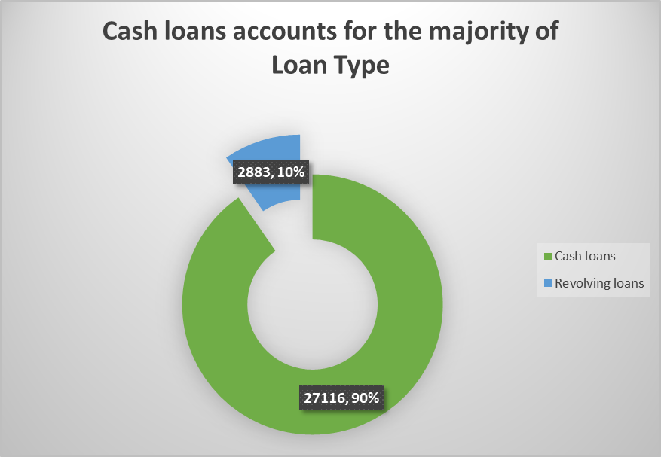
Loan Type vs Gender
Cash Loans are more popular than Revolving loans

Slide 7
Data Insights – Previous Record data Set

Slide 8
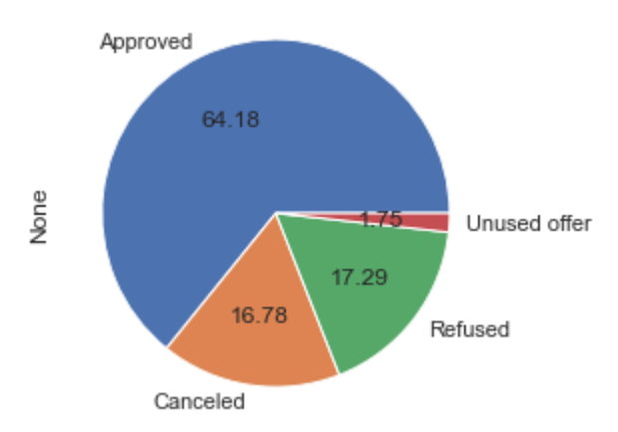
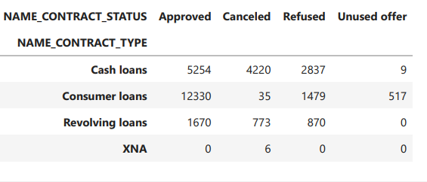
Total Loans – Value Count
Cash loans are most refused while Consumer loans are most approved

Slide 9
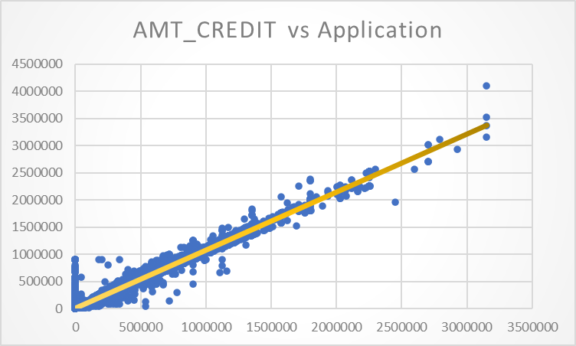
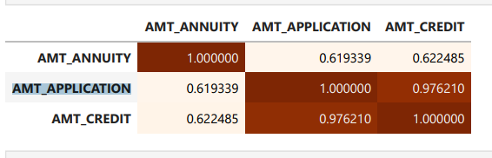
Previous Credit vs Present Credit
The amount of the applicant's withdrawal is likely to match that of its earlier application.

Slide 10
Suggestions
Attractive Interest rates should be given to Married couples.
Female Loan applicants should be subjected to intense scrutiny.
Businessmen should be given preference while processing the loan file because they typically pay on time compared to members of the working class.

Slide 11
Thank You

